Slide 1
Basic Principles of The Us Constitution

Slide 2
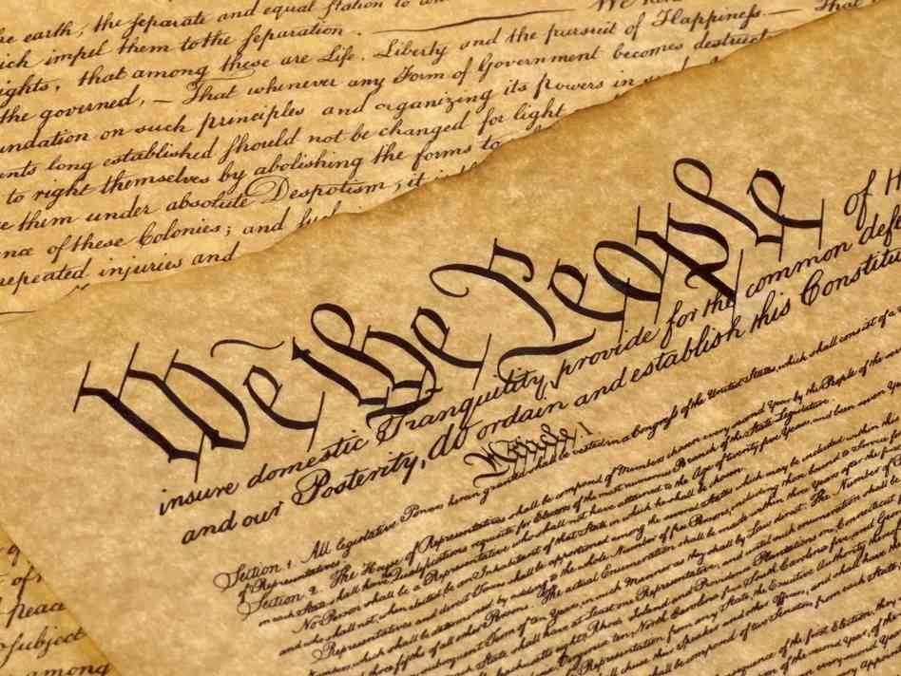
Why does the us Constitution matter?
- Document that contains the rulebook of how to run the United States Government
- Gives qualifications of our leaders
- Supreme Law of the United States
- Protects YOUR civil rights/liberties

Slide 3
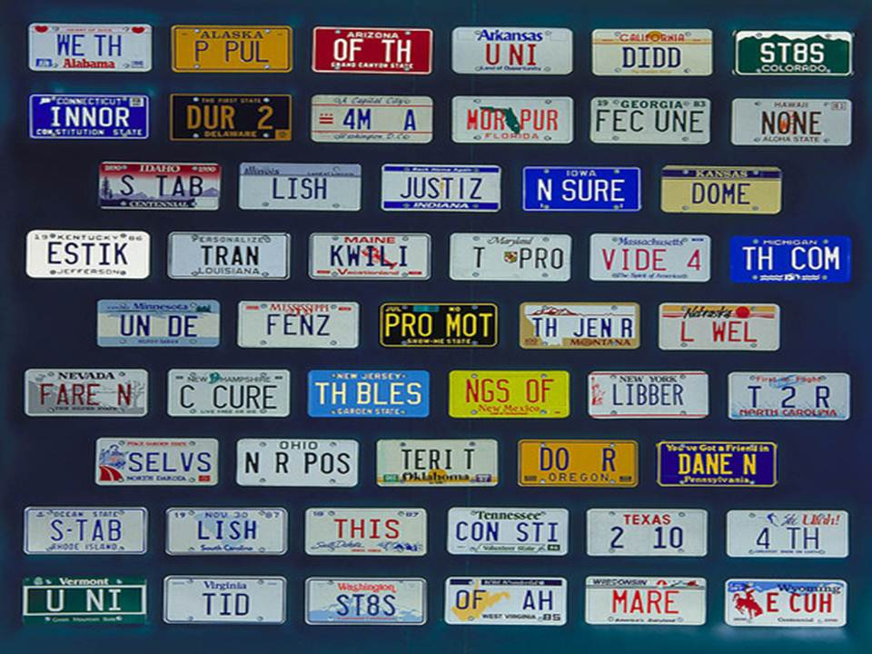
US Constitution Basics
- Ratified in 1789
- Introduction: Preamble – Outlines the intentions of the US Constitution
- Has 7 Articles (sections)
I. The Legislative Branch
II. The Executive Branch
III. The Judicial Branch
IV. Relations Among States
V. The Amendment Process
VI. National Debts, National Supremacy, Oaths of Office
VII. Requirements for Ratification

Slide 4
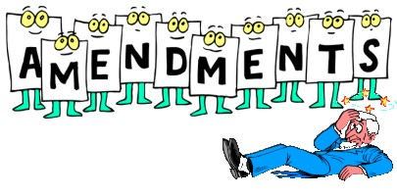
Can we change the Constitution?
- Amendment Process
Amendment – Change or add
- 27 Amendments
- 1-10 Amendments – Bill of Rights
Secured in 1791 because of the Anti-Federalists
- 13-15 Amendments – Civil War Amendments
Secured the rights of African Americans after slavery
- 15, 17, 19, 24, and 26 Amendments – Voting Rights Amendments
Secured voting rights

Slide 5
7 Basic Principles of the US Constitution
Constitution rests on 7 building blocks (tenets or principles)
Popular Sovereignty
Limited Government
Rule of Law
Checks and Balances
Separation of Powers
Federalism
Judicial Review

Slide 6
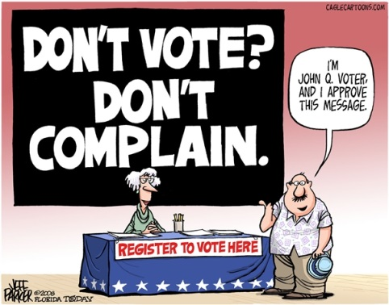
Popular sovereignty
Popular == People Sovereignty == ultimate authority
All Power is held by the People
People show power through VOTING.

Slide 7
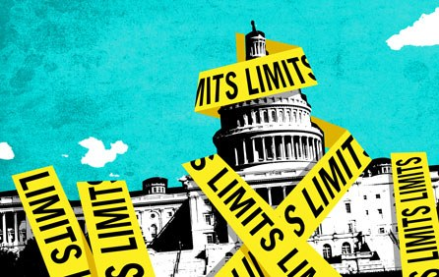
Limited Government
Government can only do what the people give it the power to do
The Bill of Rights secures Limited Government
- Government cannot violate anyone’s religious rights

Slide 8
Rule of Law
The Watergate scandal rocked the U.S. presidency in the early 1970s. The events of Watergate led to the resignation—or quitting—of President Richard M. Nixon. During the election campaign of 1972, the Democratic National Committee had offices inside the Watergate building. On June 17, 1972, at 2:30 a.m., police caught five men trespassing inside the hotel. The men were attempting to hide microphones used to secretly listen to conversations, inside these offices. The Federal Bureau of Investigation (FBI) reported that the Watergate break-in was part of widespread spying designed to help President Nixon win reelection. The following November, President Nixon won reelection. More and more people associated to Nixon resigned, were fired, or were convicted of crimes dealing with their involvement in the Watergate scandal. Meanwhile, the U.S. Senate created a committee to investigate. All telephone calls and conversations in Nixon’s offices had been recorded since 1971. When the Senate Watergate Committee and a case lawyer asked to hear these tape recordings, Nixon refused to hand the tapes over. The U.S. Supreme Court ordered Nixon to hand over tapes of 64 White House conversations. Days later, the House of Representatives passed one of three articles required to impeach the President. The following month, on August 8, 1974, Nixon announced his resignation. It was the first time in history that a U.S. president had resigned.

Slide 9
What is Rule of law?

Slide 10
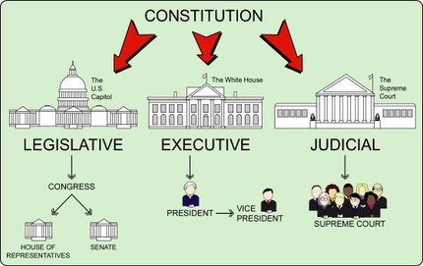
Separation of powers
Article 1: Legislative Branch – make the laws
Represents a district or state
Serves 2 or 6 years
Article 2: Executive Branch – enforces the laws
Represents the whole country
Serves 4 years
Article 3: Judicial Branch – interprets the laws
Represents the Constitution
Serves for life

Slide 11
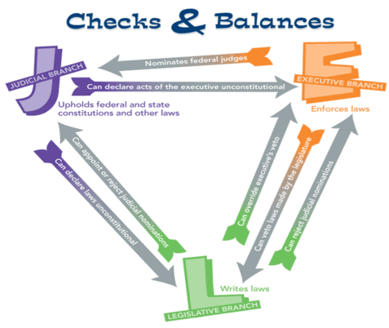
Checks and Balances
Each branch holds some control over the other branches.
Example: The president nominates the Supreme Court Justices but the Senate must approve of the nominations.

Slide 12
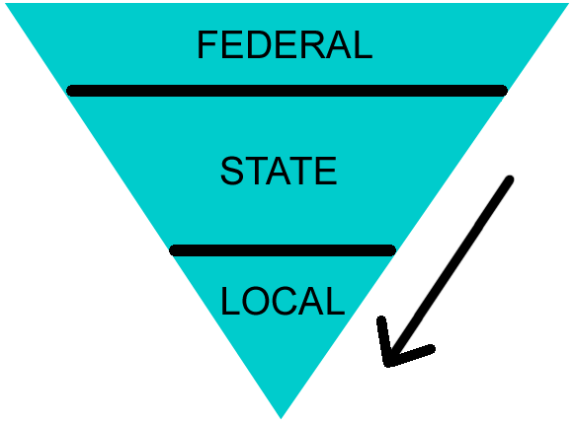
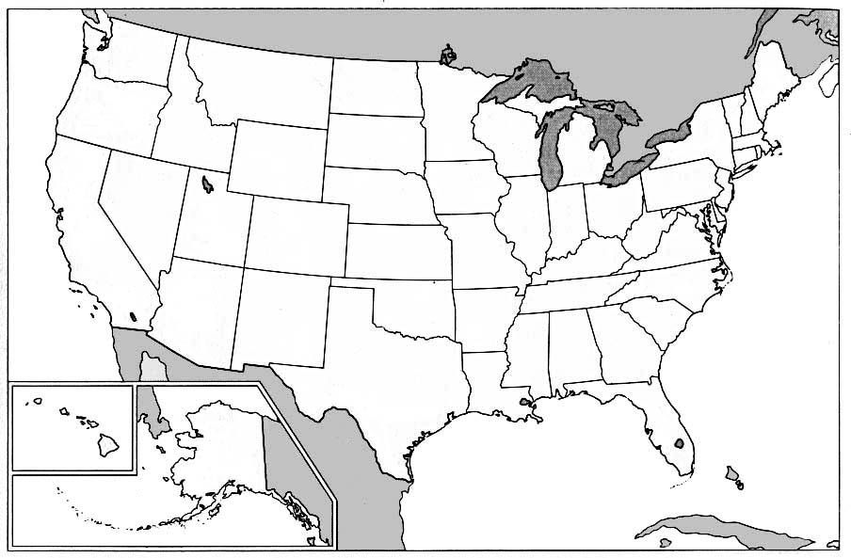
federalism
Responsibilities are shared between the National Government and the State Governments.
Compromise between a Unitary Government (Britain) and a Confederation (Articles of Confederation)
EX: Organization of a school

Slide 13
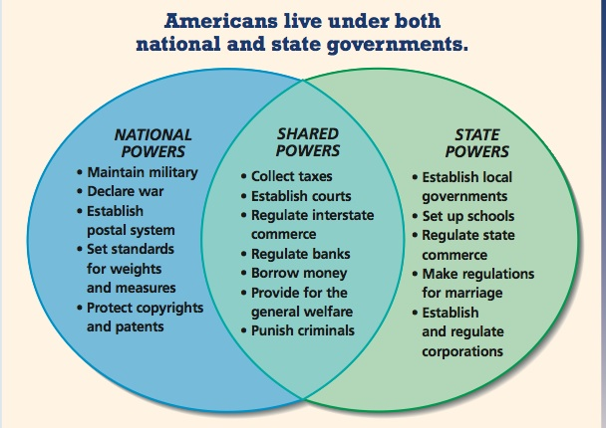

Slide 14
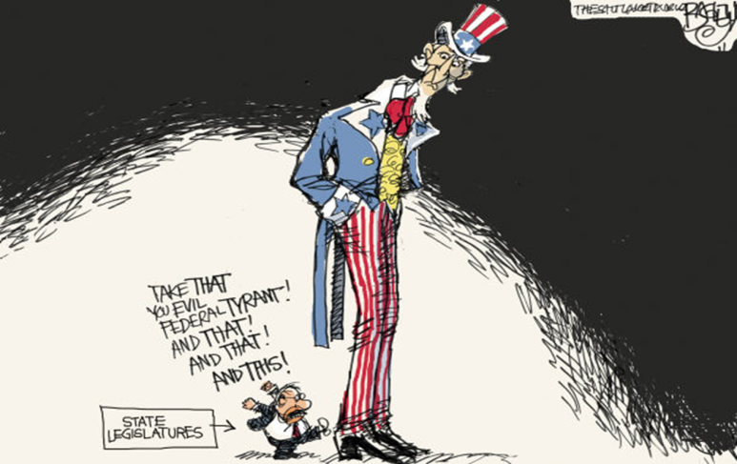

Slide 15
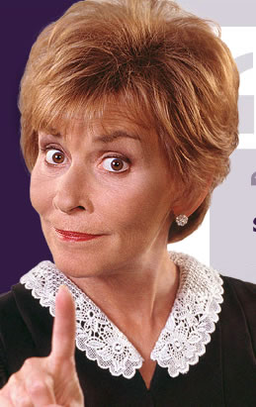
Judicial review
Courts have the power to declare laws and actions of Congress and the President unconstitutional (illegal).
This was established by Marbury v Madison in 1803.
A decision can only be changed by another Court decision or an Amendment.

